Slide 1



Impact of Tariffs on Imported Goods Prices
Scenario Analysis
D214 Data Analytics Graduate Capstone
Western Governors University
Kiara Angelys Ganger

Slide 2


Agenda
Topics Covered
Problem and Hypothesis
Data-Analysis Process
Findings
Limitations
Proposed Actions
Expected Benefits

Slide 3

Introduction
Hi, I’m Kiara Ganger. I have a background in data governance and analytics specialist for the state of Washington
Mother of 3 boys
Love K-Drama and Bookbinding

Slide 4



Problem Statement
and
Hypothesis
GO BACK TO AGENDA PAGE

Slide 5


How will the proposed tariffs impact the cost of goods sold (COGS) for small businesses importing from China and Mexico?
This study tested two possible outcomes:
Null Hypothesis (H₀)
Alternate Hypothesis (H₁)
tariffs on goods from China and Mexico would not make it more expensive
tariffs on goods from China and Mexico would make it more expensive

Slide 6
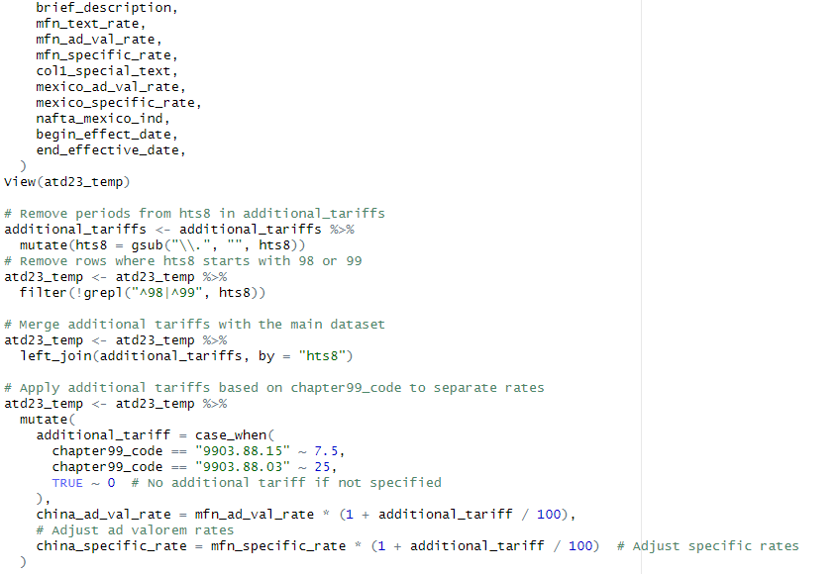
Data-Analysis Process
Data Collection
Scenario Modeling
Comparative Analysis (baseline vs. scenarios).

Slide 7

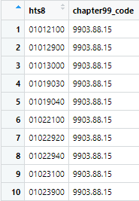
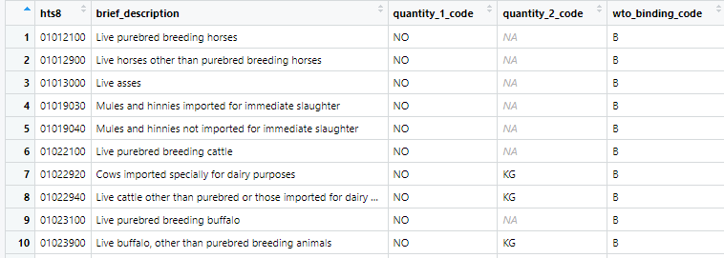
Data Collection
The data collected for this analysis was collected from two sites: Harmonized Tariff Scheduled(HTS) of the United States and USITC DataWeb:
Annual Tariff Data for 2023 (Annual Tariff Data, 2023, [Dataset], 2024):
This dataset gives detailed information on tariffs applied to goods imported to the US. Including specific and ad valorem rates for goods coming from Mexico and the MTNs(which includes China)
Additional Tariffs (Harmonized Tariff Schedule, 2024):
This dataset is a supplemental listing of the extra tariff imposed on China in subchapter III, Chapter 99 marked with code (.1) of 7.5% or 25% (Harmonized Tariff Schedule of the United States, 2024).

Slide 8
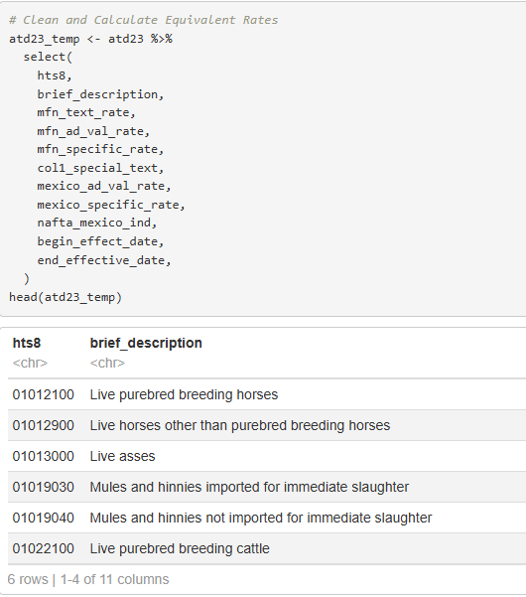
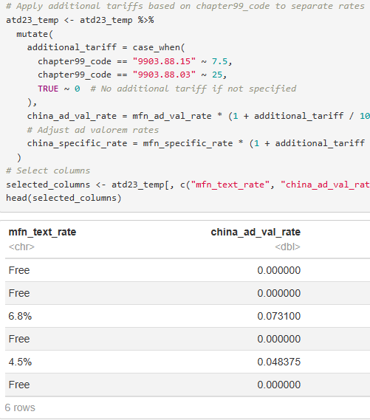
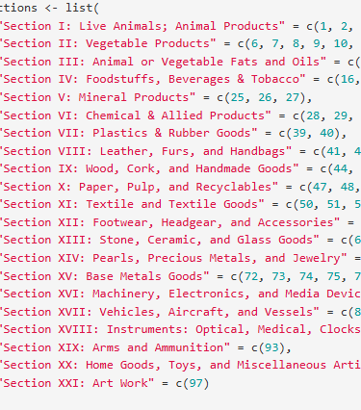
Data Cleaning
I removed any unneeded columns, combined the datasets, calculated the tariff rates, and created a section column to group HTS code by chapters

Slide 9
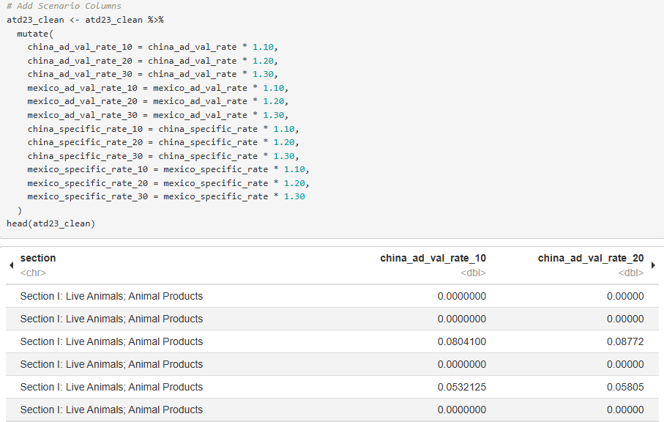
Scenario Modeling
I created scenarios to simulate 10%, 20%, and 30% tariff increases for both ad valorem and specific rates.

Slide 10
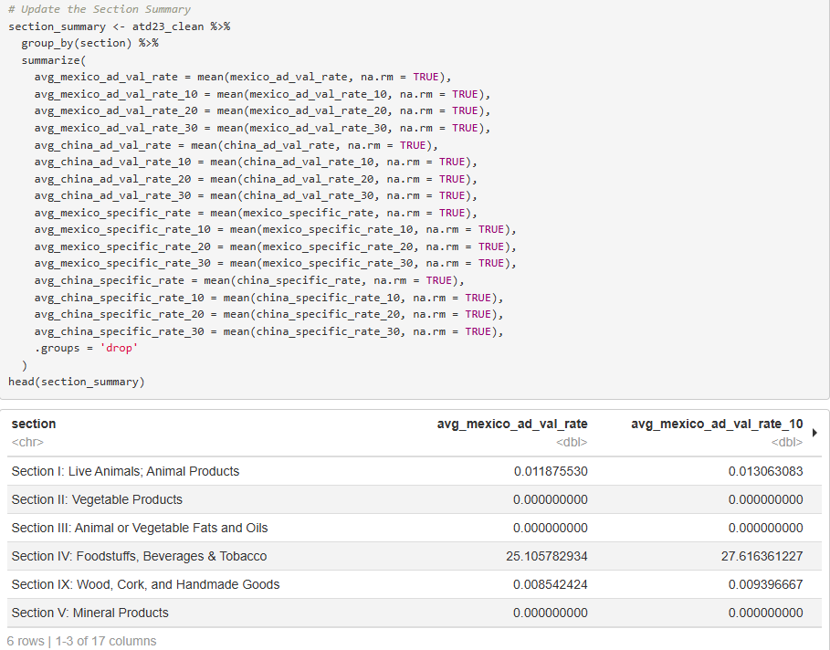
Comparative Analysis
I calculated the average tariff rates across product categories and identified the most affected sections

Slide 11
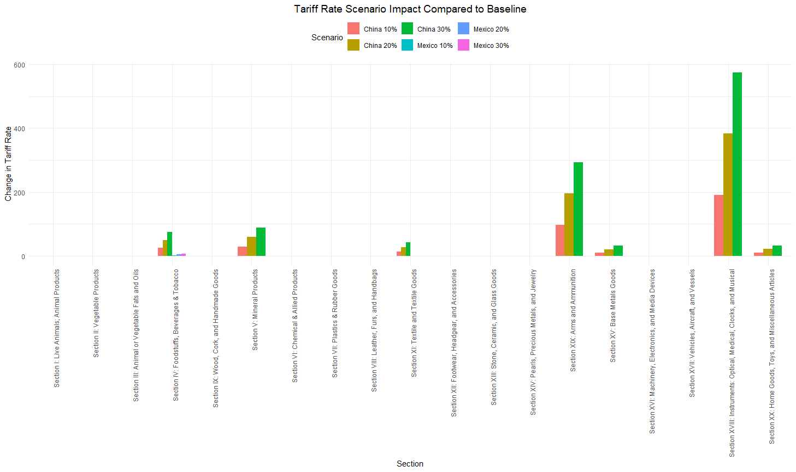

Comparative Analysis cont.
This chart shows how increasing tariffs by 10%, 20%, and 30% affects different types of products imported from China and Mexico. Each bar represents the added cost due to the tariff increases. For example, categories like food, mineral products, and medical instruments see the biggest increases,

Slide 12
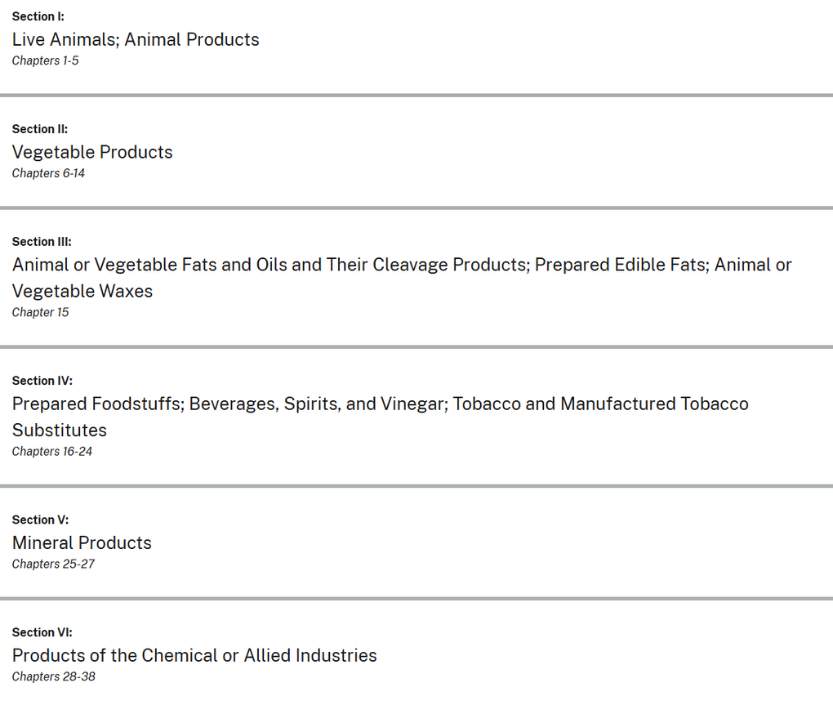

Findings
key impacted sections
Real world example
Briefly elaborate on what you want to discuss.
Briefly elaborate on what you want to discuss.

Slide 13
Most affected sections
Section IV: Foodstuffs, Beverages & Tobacco
Section VI: Chemical & Allied Product
Section XIX: Arms and Ammunition
With China being the most affected by the increases
Section | Country | Baseline Tariff Rate | 10% Increase | 20% Increase | 30% Increase
Section IV | Mexico | 25.11 | 27.62 | 30.13 | 32.64
 | China | 249.5 | 274.40 | 299.35 | 324.30
Section VI | Mexico | 0.0037 | 0.0041 | 0.0046 | 0.0048
 | China | 0.041 | 0.0455 | 0.0496 | 0.0538
Section XIX | Mexico | 0.000 | 0.000 | 0.000 | 0.000
 | China | 977.29 | 1075.02 | 1172.74 | 1270.47

Slide 14
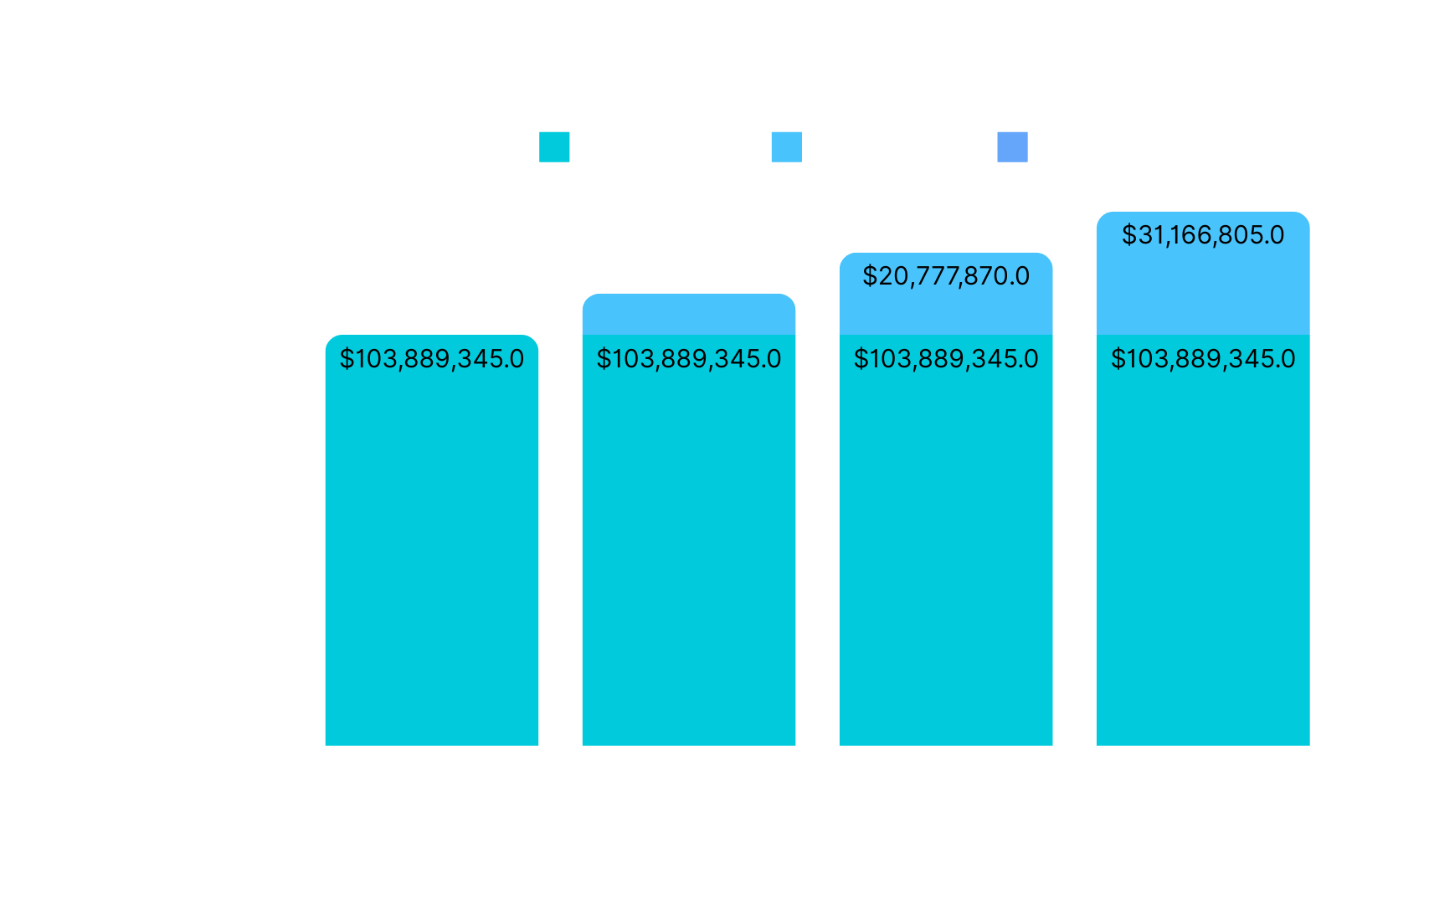
Real-World Example:
Impact of Tariff Increases on 2024 Coffee and Tea Imports
These increases highlight a direct and measurable impact on COGS, which can challenge small businesses operating on tight margins. Data source (Administration, 2024)

Slide 15

Limitations of Techniques and Tools
Hypothetical Data
Tool Constraints
Data Granularity
Data Assumptions
The analysis relies on estimated COGS data, which may not reflect real-world variations
The tools used:
R
Excel
Can be limited by their computational capacity and dependency on clean, structured data
The analysis groups tariffs by section, which might overlook product-specific nuances
the analysis is the assumption of a linear relationship between tariffs and costs

Slide 16


Proposed Actions
Find new suppliers.
Strategically adjust pricing or prioritize high-margin products
Explore alternative markets

Slide 17






Expected Benefits of the Analysis
Stay Ahead of Tariff Changes
Increased costs due to tariffs
Renegotiating contracts
Exploring alternative suppliers
Effective Cost Management
Small businesses can strategically allocate resources
Enhanced Decision-Making
Businesses can make informed decisions
By leveraging this analysis, businesses can safeguard profitability and remain competitive in a changing trade landscape.

Slide 18
Thank you!
The increase in tariffs can hurt many small businesses. With the right strategies, businesses can adapt and thrive despite these challenges

Slide 19











Resource
Page
Administration, I. T. (2024, December). Office of Consumer Goods Import Data Tools. Retrieved from International Trade Administration: https://www.trade.gov/data-visualization/office-consumer-goods-import-data-tools
Annual Tariff Data, 2023, [Dataset]. (2024). Retrieved from DataWeb: https://dataweb.usitc.gov/tariff/annual
Harmonized Tariff Schedule of the United States. (2024). Chapter 99. Retrieved from hts.usitc.gov: https://hts.usitc.gov/search?query=990388

